Slide 1
A spiking neural architecture that learns tasks
Niels Taatgen
Bernoulli Institute for Mathematics, Computer Science and Artificial Intelligence
University of Groningen

Slide 2
ACT-R
PRIMs
Nengo

Slide 3
Nengo/PRIMs/ACT-R
LTM
Goal
Vision
WM
Mem1
Mem2
Action
Combined
State
BG
Thalamus
Mapping
PRIM:
WM->Mem1

Slide 4
Combined State
One semantic pointer with all the buffer slots
State = vision1 * NINE + vision2 * BLACK + goal * WMTASK + memory1 * NINE + etc.
Testing conditions is less explicit

Slide 5
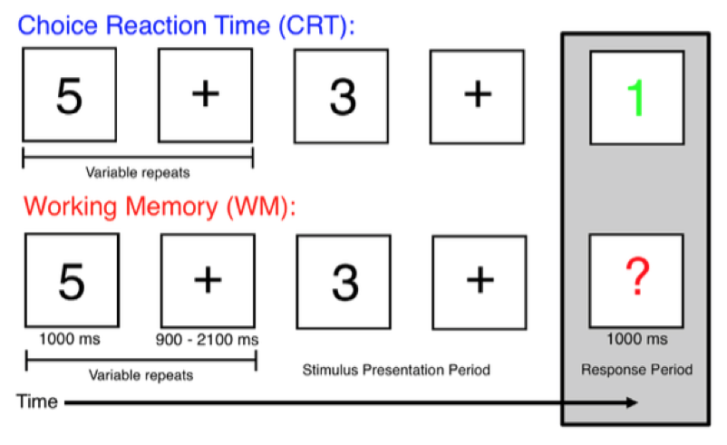
Example: Smallwood et al. 2011
Result: More mind-wandering during the CRT than the WM task

Slide 6
State->PRIM mapping with Winner-Take-All network
'G1*WMTASK + V1*FOUR + V2*BLACK' : 'V1WM1',
'G1*WMTASK + V1*QUESTION + V2*RED' : 'WM1RT1',
'G1*WMTASK + RT2*(ODD + EVEN)' : 'RT2AC1’,
'G1*CRTTASK + V1*FOUR + V2*BLACK' : 'NOACTION',
'G1*CRTTASK + V1*FOUR + V2*RED' : 'V1RT1',
'G1*CRTTASK + RT2*(ODD + EVEN)' : 'RT2AC1’,
'RT2*EPISODE' : 'RT2WM1',
'WM1*EPISODE' : 'WM1RT1'

Slide 7
BG/Thalamus actions
spa.ifmax(
spa.dot(prim, s.V1RT1), vision1 >> memory1)
spa.ifmax(
spa.dot(prim, s.RT2AC1), memory2 >> action)
spa.ifmax(
spa.dot(prim, s.V1WM1), vision1 >> wm)
spa.ifmax(
spa.dot(prim, s.WM1RT1), wm >> memory1)
spa.ifmax(
spa.dot(prim, s.RT2WM1), memory2 >> wm),
spa.ifmax(0.5, s.EPISODE >> memory2)

Slide 8
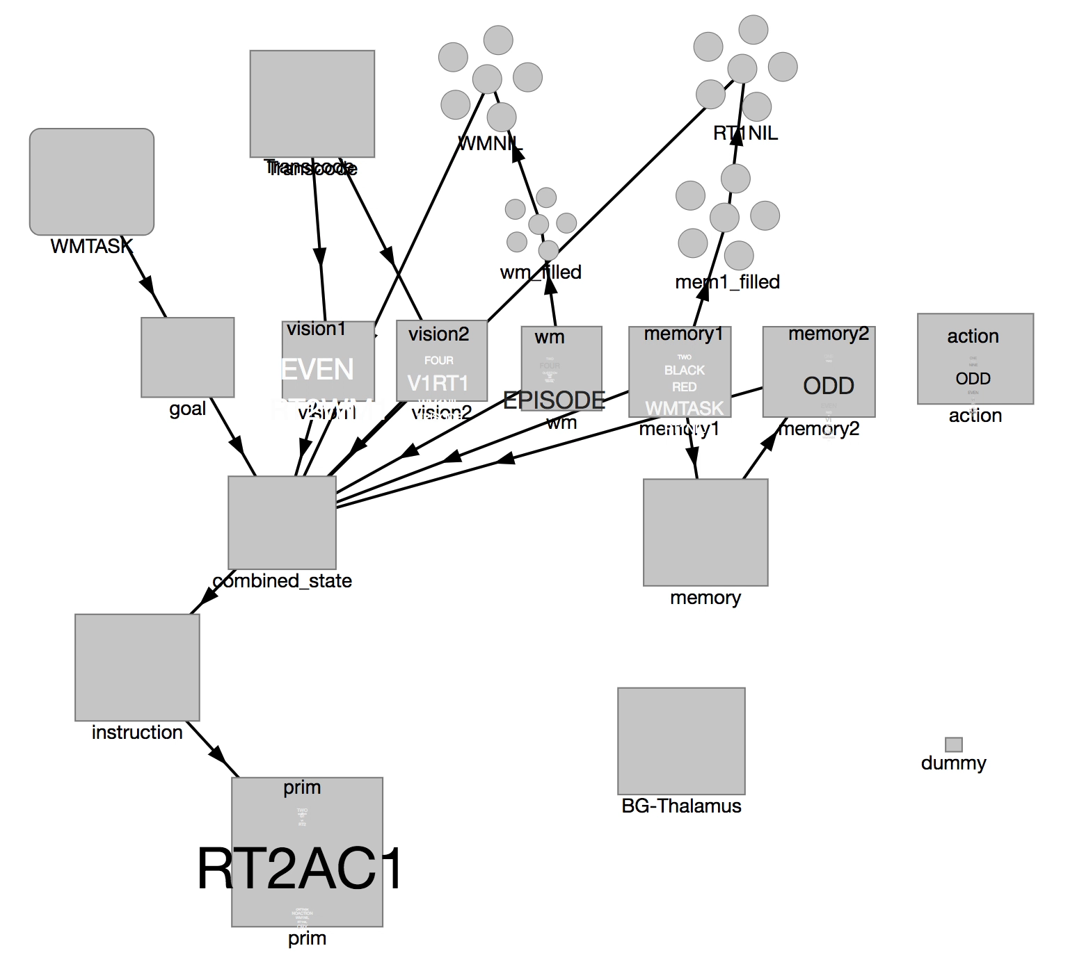
WM task

Slide 9
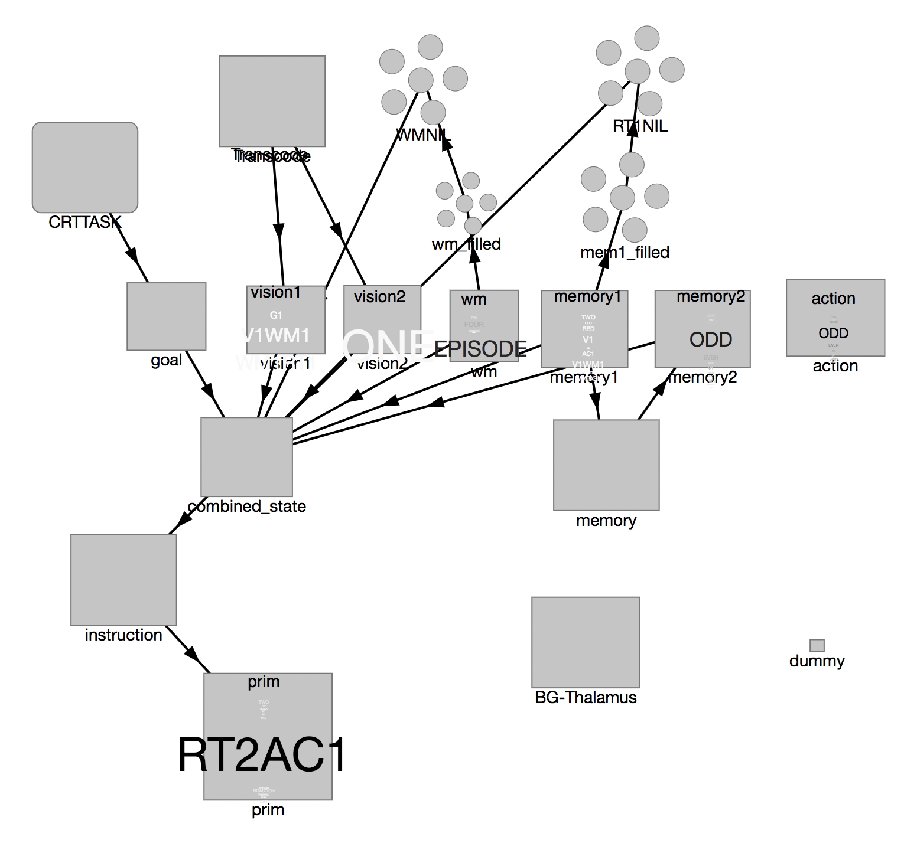
CRT task

Slide 10
Model can reproduce Smallwood et al. results
But: we have to hand-code the task-specific knowledge
Can’t the model learn it itself?
--> Use PES learning to learn the mapping between the combine state and the Action
We train the model 15x by showing the correct action, then it is on its own.

Slide 11
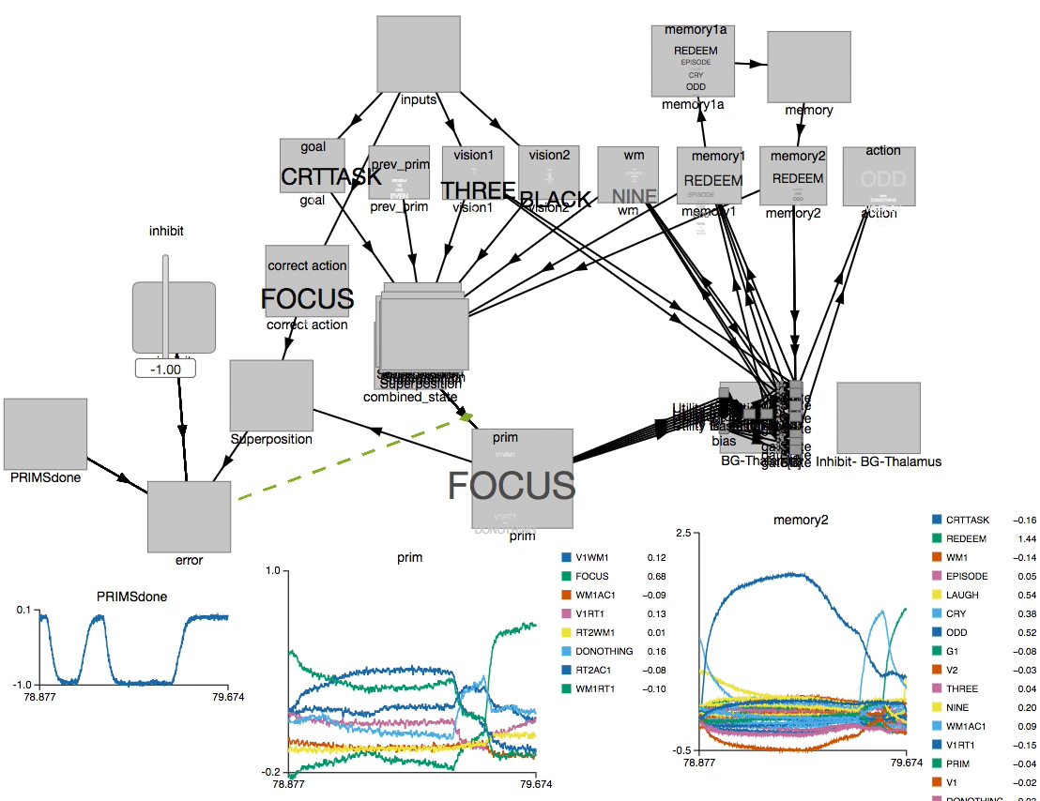

Slide 12
Setup
Train the model for 40 trials
Then look at the Basal Ganglia input
And the activity in declarative memory

Slide 13
Results

Slide 16
Lessons learned
Instead of explicitly testing conditions, it is better to use the state of the system as the cue for the next action
Semantic pointers (vectors) have an advantage over straight symbols
Future work (lots!)
Implement operator level
Variable binding
Compiling PRIMs for transfer learning

